Slide 1
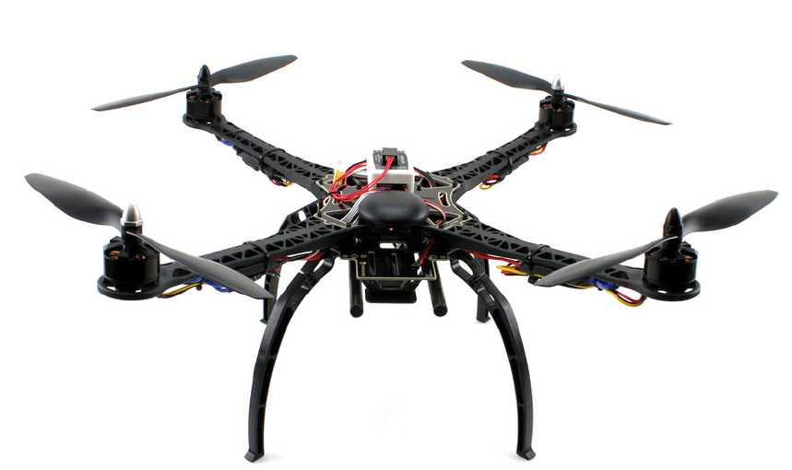
Non-Linear Control Approaches for Quadrotor UAVs
By: Kevin Hu

Slide 2
Non-Linear Control Techniques
Integral Backstepping
Sliding Mode Control
Feedback Linearization

Slide 3








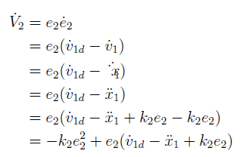



Integral Backstepping
Notes:
Virtual control variable v_1

Slide 4






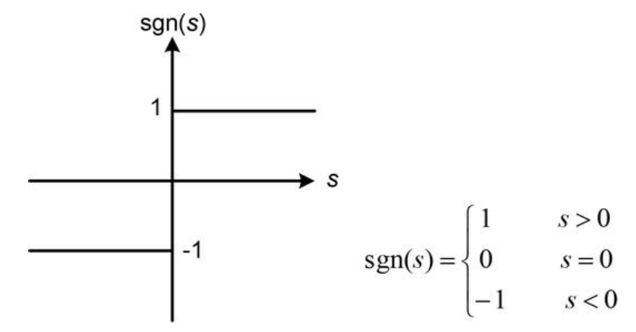
Sliding Mode Control
Notes:
A sliding mode controller constrains a system to a sliding surface $s$, which can be separated into two phases, the reaching phase and then a sliding phase. During the reaching phase, trajectories not on the surface $s = 0$, converge towards it and reaches it in a finite amount of time. Then the sliding phase begins and motion is constrained to the surface.

Slide 5

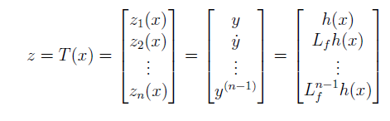

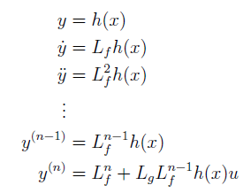
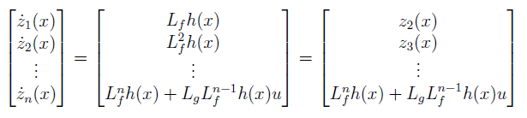

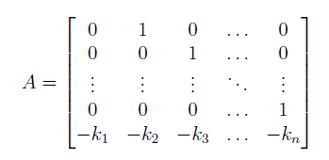
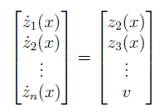

Feedback Linearization In One Dimension

Slide 6


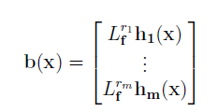





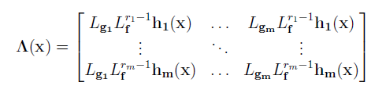
Feedback Linearization in Multiple Dimensions

Slide 7


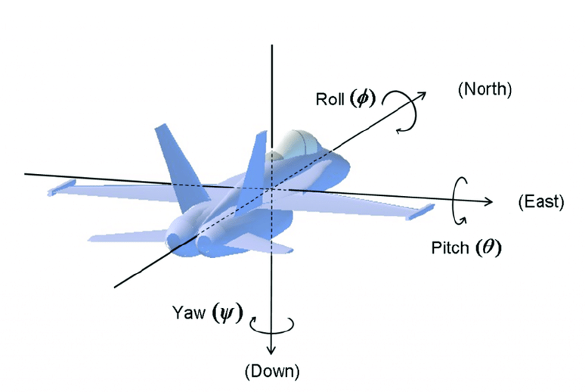
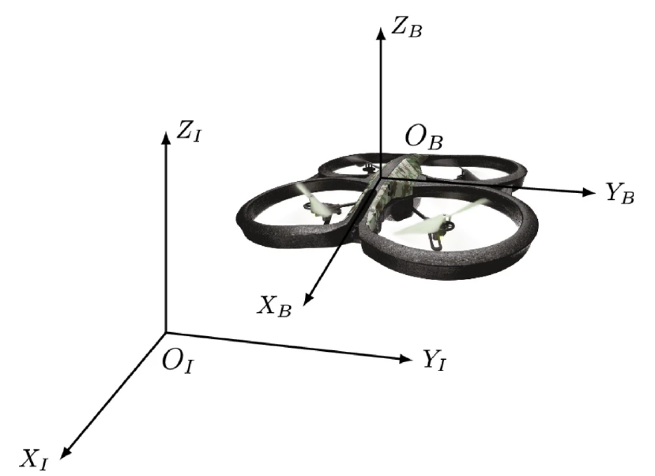
Quadcopter Modeling

Slide 8
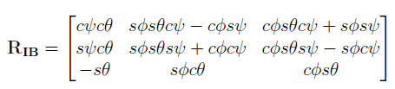

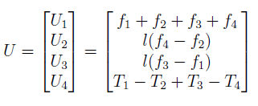
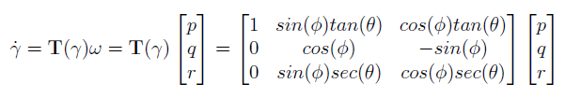
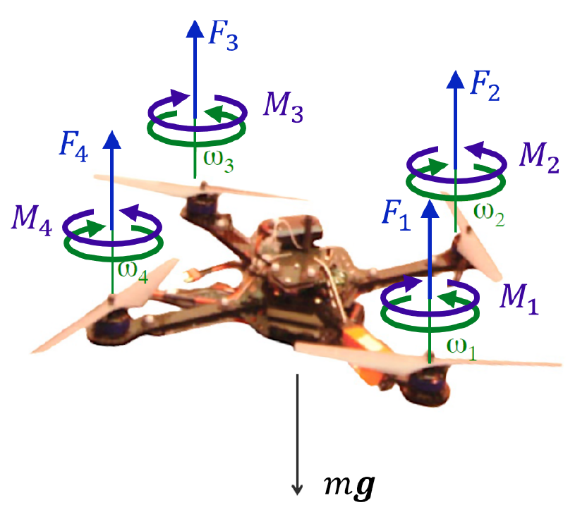

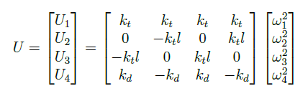

Quadcopter Modeling

Slide 9
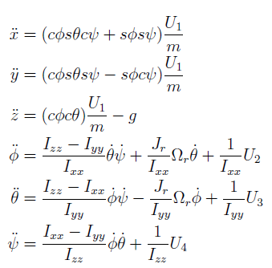

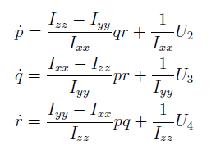

Equations of Motion

Slide 10
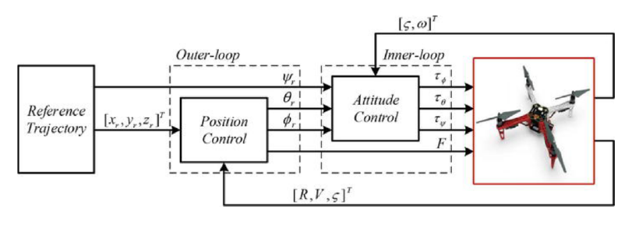
Quadcopter Control

Slide 11
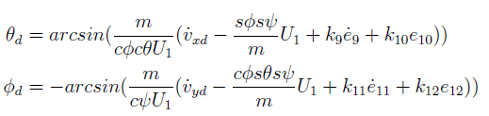




Integral Backstepping

Slide 12



Sliding Mode Control Overview

Slide 13
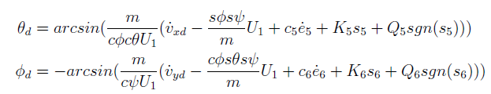






Sliding Mode Control

Slide 14









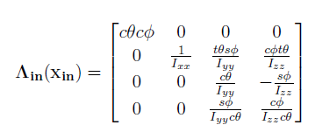
Feedback Linearization
Notes:
Solve gains using LQR

Slide 15
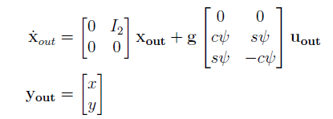



Zero Dynamics Control

Slide 16
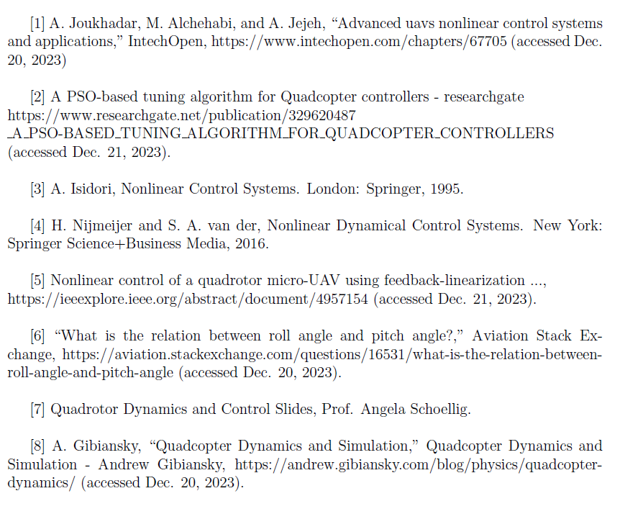
References

